Slide 1



The Effects of the Martian Atmospheric Conditions on a NACA 4412 Airfoil
Alex Higuera Pierre Noel, Presenter
Sergey Shkarayev, Mentor
Arizona Space Grant Consortium Symposium
Tempe, Arizona
April 21-22, 2023

Slide 2
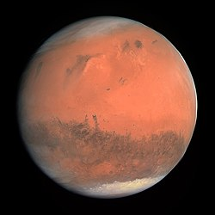
Mars’ Significance
Mars represents our current main planet exploration objective.
Its proximity is an important factor.
The scientific interest is endless, as well as its potential.
Mars photo taken by the Rosetta space probe (ESA)

Slide 3
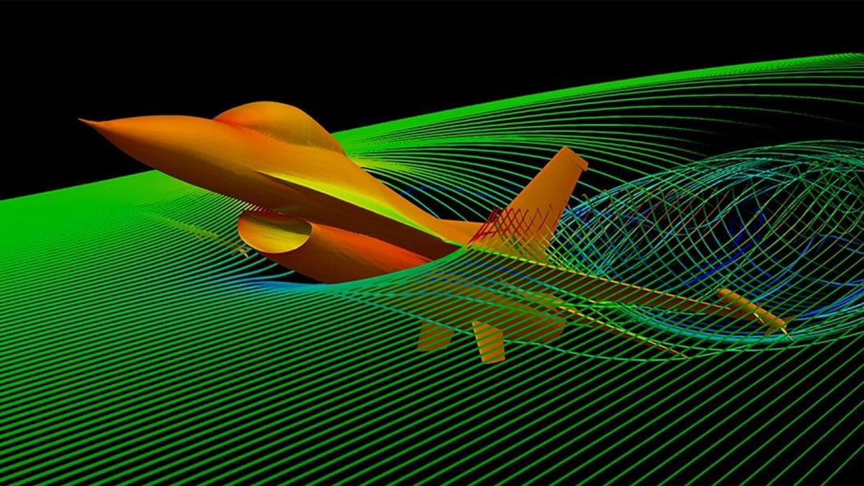
CFD: Why is it Important?
CFD stands for Computational Fluid Dynamics.
CFD simulations are a fundamental tool for engineering and science.
Simulating Mars and its conditions is one of the many examples.
An example of CFD by flowgy.com

Slide 4
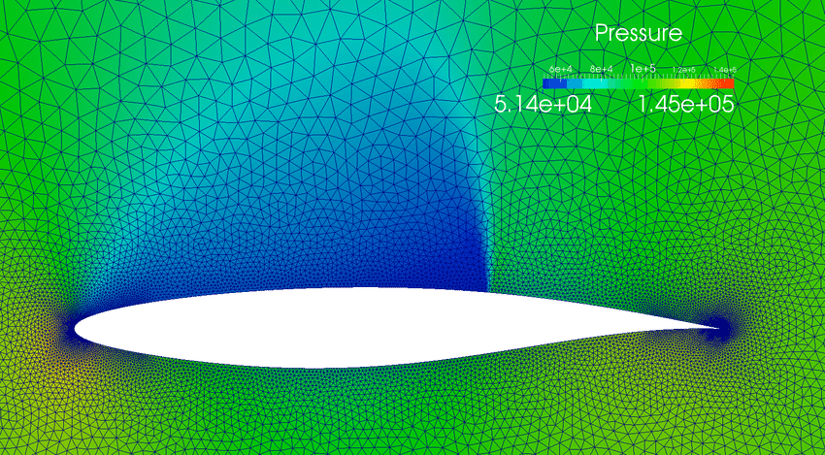
Simulating Mars and its Conditions
Adapting to all relevant conditions is imperative.
Density is about 0.020 kg/m³.
Atmospheric Pressure is about 600 Pa.
This says that Mars’ atmosphere is thinner than the Earth’s
The difference can be seen in, for instance, an airfoil.
CFD on an airfoil by researchgate.net

Slide 5
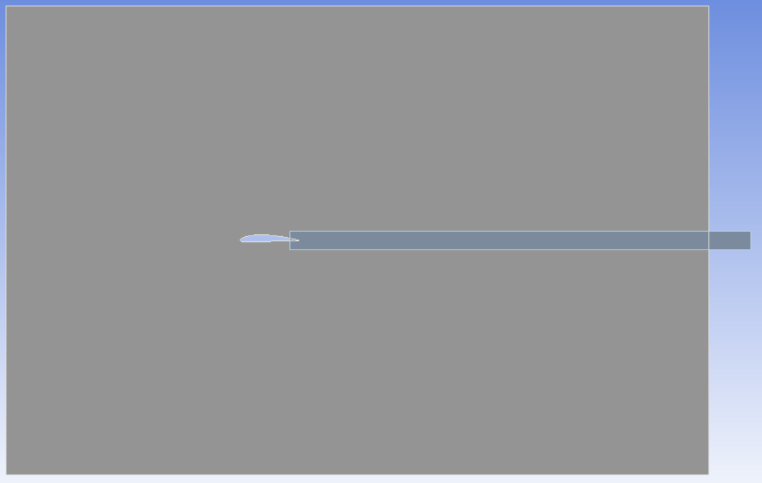
CFD Model
ANSYS Fluent is an example of a CFD solver.
Take any airfoil, in this case a NACA 4412.
By generating the necessary geometry, airflow over the airfoil can be simulated.
Start by the extrusion.
Body of influence was added
Geometry for the simulation, including the body of influence (colored in blue).

Slide 6
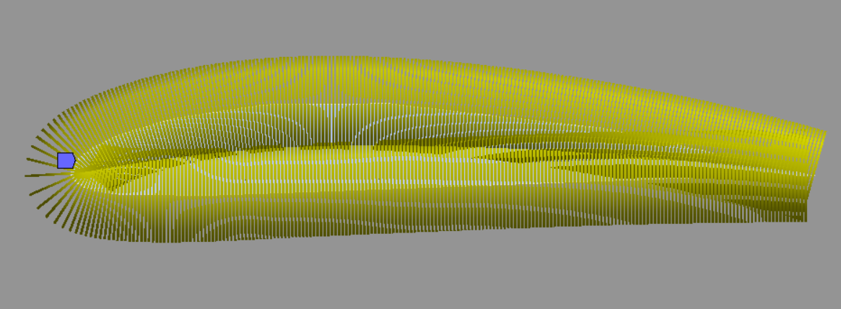
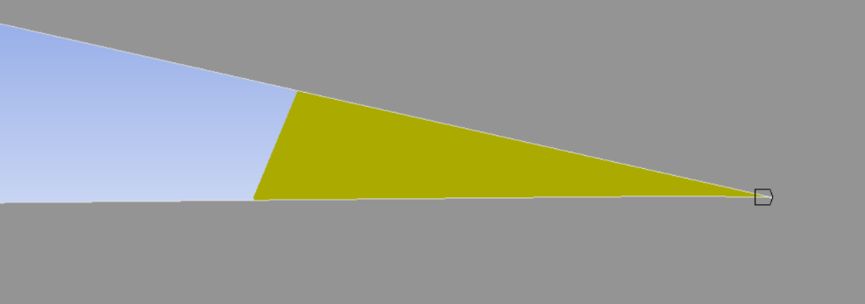
CFD Model
With the geometry done, it is time to create the mesh.
Each individual element of it is analyzed and then accounted for.
This method is known as Finite Element Analysis (FEA).
Generally, the finer the grid is, the better.
Meshing of the airfoil’s outline on the figure. The two different sections are due to how the outline was created.

Slide 7
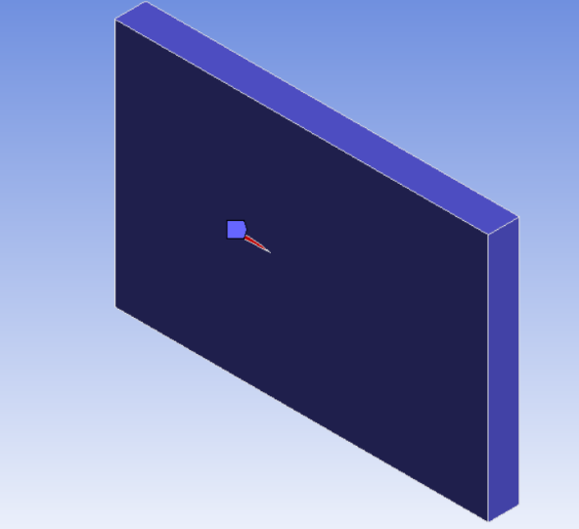
CFD Model
The next is to apply inflation to the whole body.
As boundary for the inflation, the airfoil is used.
As said formerly, a fine mesh is desirable.
This process is very common and useful
Inflation is applied through the whole surface.

Slide 8
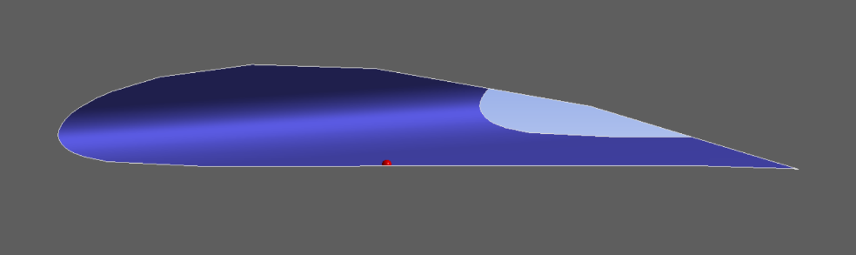
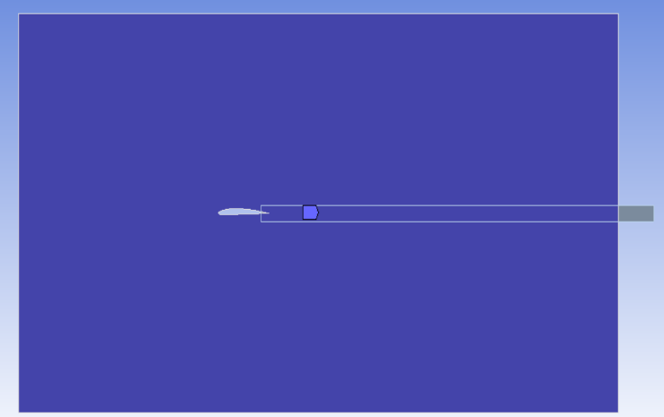
CFD Model
Establish the element size for all faces, including the airfoil’s inner.
For the whole body, body of influence is used
This and all previous steps represent a common meshing methodology
Name all relevant sections
Inflation is applied through the whole surface.

Slide 9
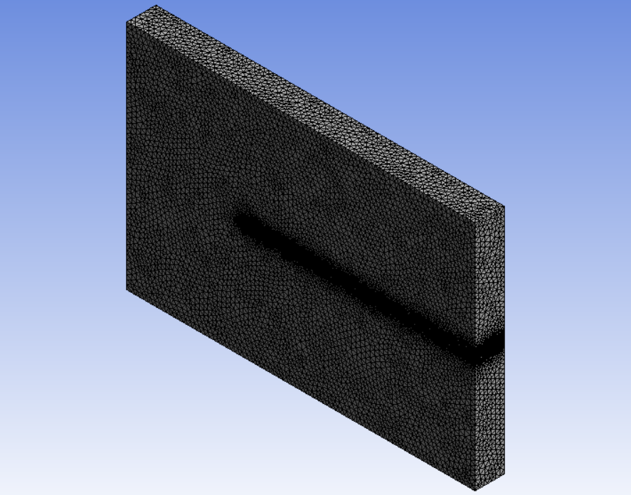
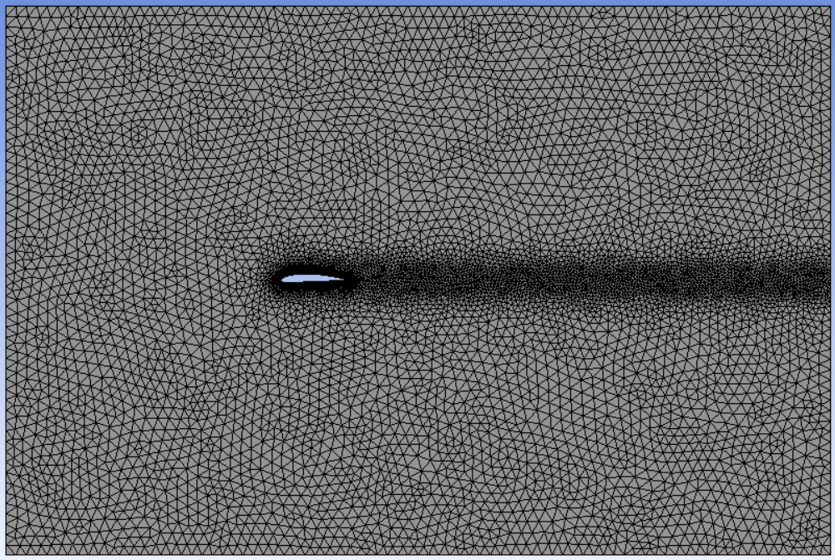
CFD Model
Isometric view of completed mesh.
Closer view of the mesh

Slide 10
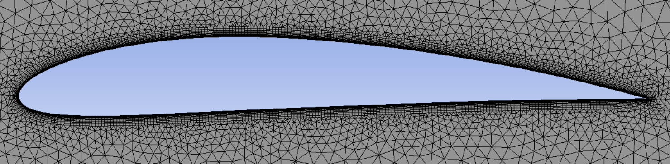
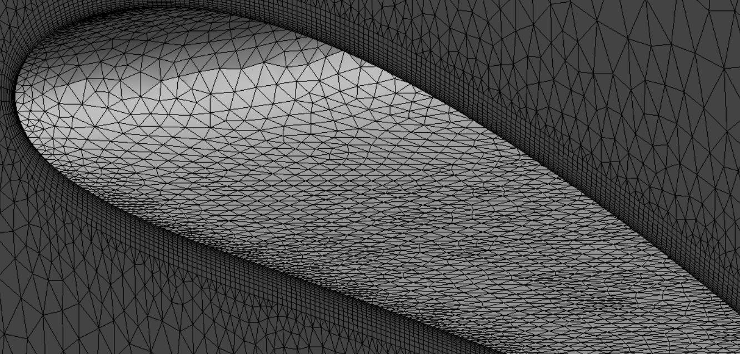
CFD Model
[1]
[2]
[1] A more detailed view of the meshing on the airfoil’s edges
[2] A close view of the inner meshing for the airfoil

Slide 11
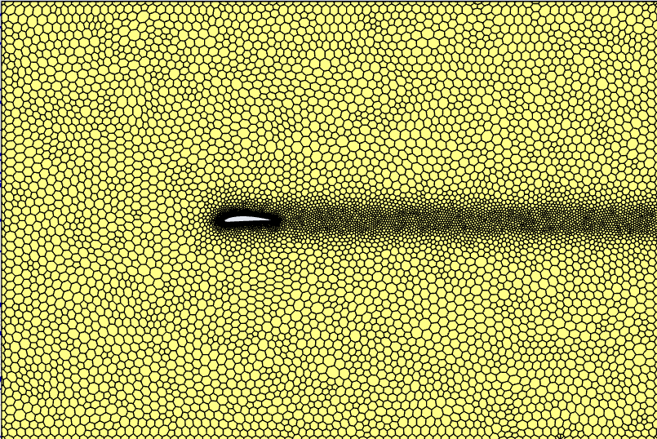
CFD Model
Now the problem can be taken to ANSYS Fluent.
First off, setting a polyhedral mesh pattern, which is desirable
The model to be used is k-omega Shear Stress Transport (SST)
Polyhedral mesh pattern applied through Fluent

Slide 12
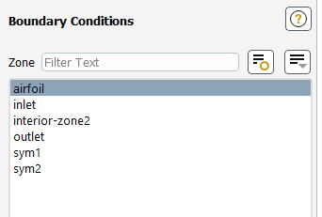
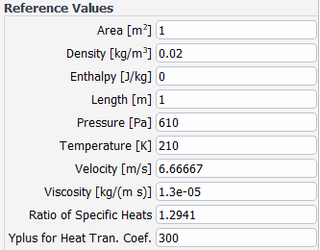
CFD Model
Set the different sections as their respective role
Assign the specific reference conditions for Mars
Create lift and drag coefficient definitions
Initialize and start the calculations
Boundary conditions and reference values

Slide 13
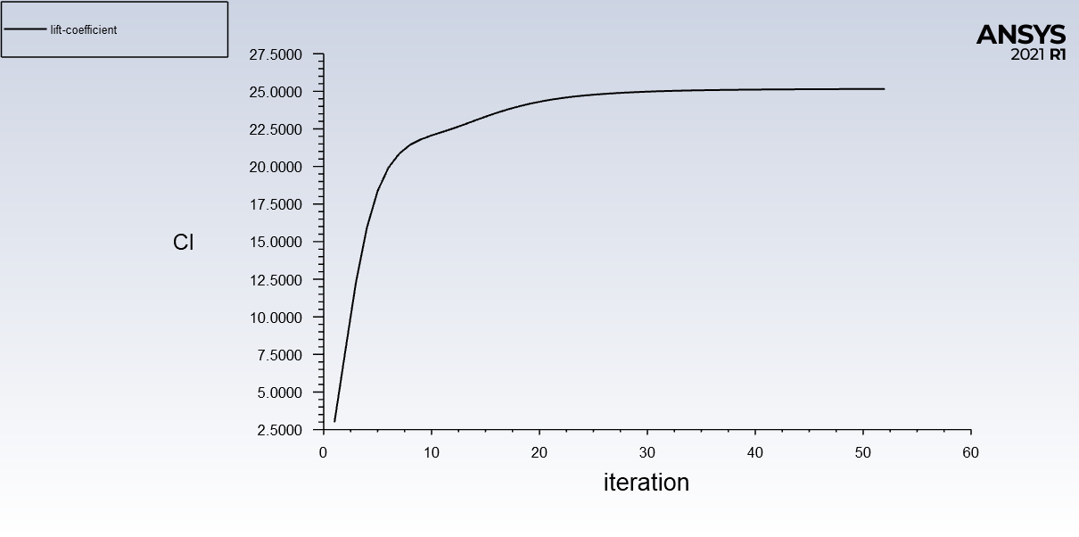
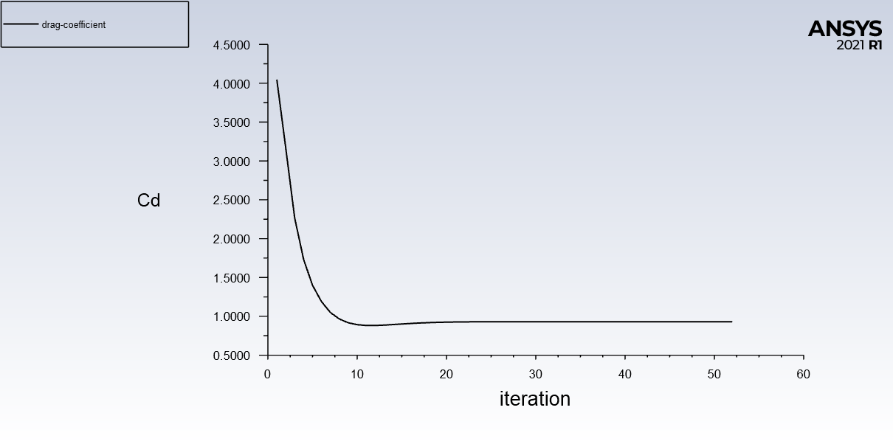
CFD Model
As calculations are performed, the solutions converge
The flatter the curve, the more accurate the result if the setup is right
The relevant data is printed into Fluent’s console
The process is repeated varying angle of attack
The convergence of a solution in Fluent

Slide 14
Results
Lift Coefficient (Cl) vs Angle of Attack (α) plot ranging from α=0 to α=20

Slide 15
Results
Drag Coefficient (Cl) vs Angle of Attack (α) plot ranging from α=0 to α=20

Slide 16
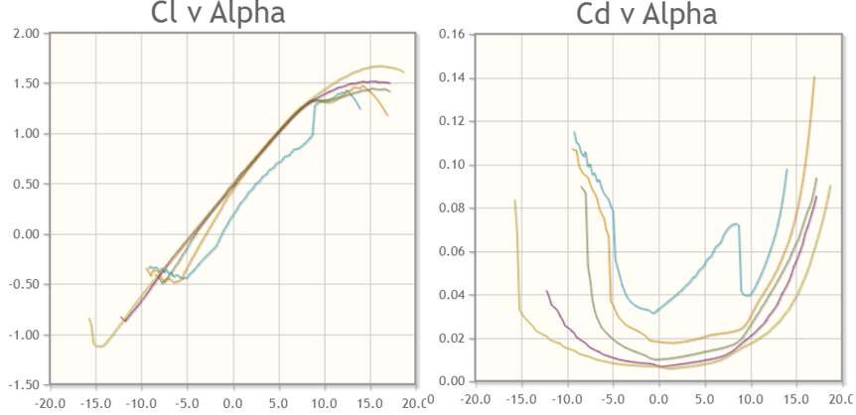
Results
Lift Coefficient (Cl) and Drag Coefficient (Cd) vs α plots for various Reynolds numbers, all of them determined through Xfoil (airfoiltools.com)

Slide 17
Significance
More easily identifiable adjustments for Mars
Cost effective, accurate simulations of Mars
A better understanding of the studied phenomena
Showing to the world that flight on Mars is more than possible
Making the understanding of these topics and experimentation more accessible
Cementing the importance of CFD and its applications

Slide 18
Acknowledgements
Sergey Shkarayev, my Space Grant mentor
Adrien Bouskela, who oriented me during the whole project
The AME department for providing the infrastructure
Michelle Coe, Arizona/NASA Space Grant Program manager and a huge source of support and motivation
The rest of the Arizona Space Grant team for this opportunity

Slide 19
Thank you

